Slide 1
Ensemble learning
Basic Ensemble Techniques
Max Voting
Averaging
Weighted Average
Advanced Ensemble Techniques
Stacking
Blending
Bagging
Boosting
Algorithms based on Bagging and Boosting
Bagging meta-estimator
Random Forest
AdaBoost
GBM
XGB
Light GBM
CatBoost

Slide 2
Ensemble learning
Ensemble learning is a new direction of machine learning
Techniques that create multiple models and then combine them to produce improved results. And also same model on different subsets of data.
Ensemble methods usually produces more accurate solutions than a single model.
This has been the case in a number of machine learning competitions, where the winning solutions used ensemble methods.
In the popular Netflix Competition, the winner used an ensemble method to implement a powerful collaborative filtering algorithm.
Another example is KDD 2009 where the winner also used ensemble methods.

Slide 3
Ensemble scoring Techniques
Max Voting
Used for classification problems.
Multiple models are used to make predictions for each data point.
Predictions by each model are considered as a ‘vote’.
Predictions from the majority of the models are used as the final prediction.
For example,
ask 5 colleagues to rate a movie (out of 5);
Assume 3 of them rated it as 4 , 2 of them gave it a 5.
Since the majority gave a rating of 4, the final rating will be taken as 4.

Slide 4
Ensemble Techniques
Averaging
used for regression problems.
take an average of predictions from all the models and use it to make the final prediction.
For example, in the previous case, the averaging method would take the average of all the values.
i.e. (5+4+5+4+4)/5 = 4.4

Slide 5
Ensemble Techniques
Weighted Average
extension of the averaging method
All models are assigned different weights defining the importance of each model for prediction
The result is calculated as [(5*0.23) + (4*0.23) + (5*0.18) + (4*0.18) + (4*0.18)] = 4.41.

Slide 6
Ensemble algorithms in scikit learn
ensemble.AdaBoostClassifier([…]) | An AdaBoost classifier.
ensemble.AdaBoostRegressor([base_estimator, …]) | An AdaBoost regressor.
ensemble.BaggingClassifier([base_estimator, …]) | A Bagging classifier.
ensemble.BaggingRegressor([base_estimator, …]) | A Bagging regressor.
ensemble.ExtraTreesClassifier([…]) | An extra-trees classifier.
ensemble.ExtraTreesRegressor([n_estimators, …]) | An extra-trees regressor.
ensemble.GradientBoostingClassifier([loss, …]) | Gradient Boosting for classification.
ensemble.GradientBoostingRegressor([loss, …]) | Gradient Boosting for regression.
ensemble.IsolationForest([n_estimators, …]) | Isolation Forest Algorithm
ensemble.RandomForestClassifier([…]) | A random forest classifier.
ensemble.RandomForestRegressor([…]) | A random forest regressor.
ensemble.RandomTreesEmbedding([…]) | An ensemble of totally random trees.
ensemble.VotingClassifier(estimators[, …]) | Soft Voting/Majority Rule classifier for unfitted estimators.

Slide 7
ensemble learning techniques
Ensemble methods are meta-algorithms that combine several machine learning techniques into one predictive model in order to
decrease
variance (bagging) --- part of the error caused by the data sample
bias (boosting) --- part of the error caused by bad model
or improve
predictions (stacking, blending).

Slide 8
stacking
Stacking is an ensemble learning technique that uses predictions from multiple models (for example decision tree, knn or svm) to build a new model.
This model is used for making predictions on the test set.
Works with classifiers and regressors alike.

Slide 9
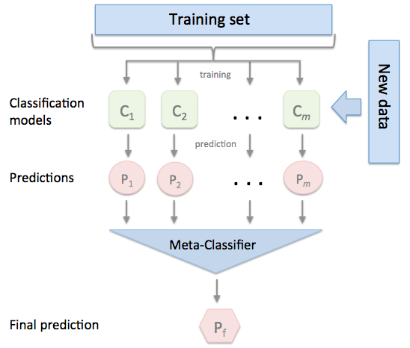
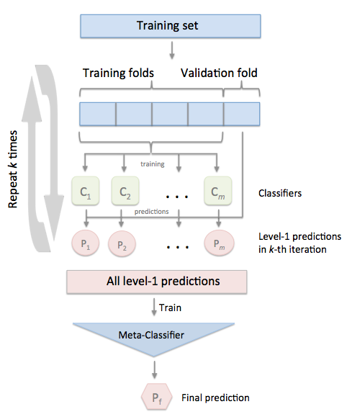
Stackingclassifier and stackingcv-classifier

Slide 10
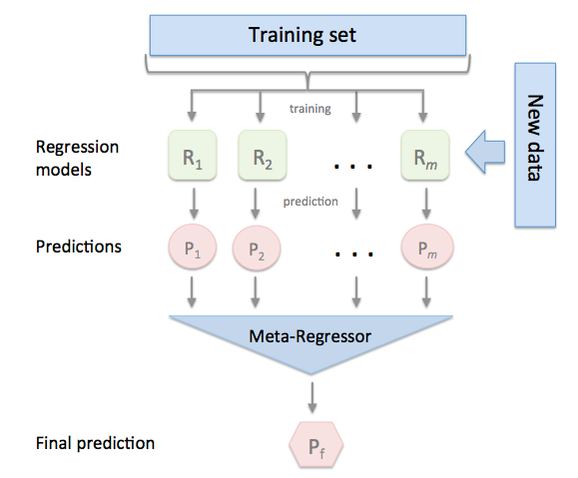
Stacking-regressor
Stacking regression is an ensemble learning technique to combine multiple regression models via a meta-regressor.
The individual regression models are trained based on the complete training set;
then, the meta-regressor is fitted based on the outputs -- meta-features -- of the individual regression models in the ensemble.

Slide 11
stacking
http://www.hubertiming.com/results/2017GPTR10K

Slide 12
When should you use a ENSEMBLE model?
When you care about improving MSE/ AUC
Need more flexibility in the model
And when you want to show to your BOSS, you tried everything !!!

Slide 13
When it may not be good
Have (really) BIG DATA
Care interpretability (lose some interpretability)
Stacked models sort of muddies the water
Hence difficult the explain Ŷ and X

Slide 14
Stacking - tips
Pick base estimators with varied structure i.e. picking 3 similar linear regression models is a NO
Pick a meta estimator than can handle high correlation
Simple meta-estimators can aid interpretability
L2 penalized logistic regression for classification
Non-negative least squares for regressions
Use continuous outputs from base estimators in classification problems

Slide 15
Blending
follows the same approach as stacking
Uses only a holdout (validation) set from the train set to make predictions.
In other words, unlike stacking, the predictions are made on the holdout set only.

Slide 16
Blending
X
y
Model 1
Dec Tree: train
Model 2
KNN:
train
X
y
Model 3
Log Reg:
train
train
X
y
Ŷ
val_pred1
Ŷ
val_pred1
validation
y
Ŷ
test_pred2
Ŷ
test_pred2
X
y
Y
test_pred
X
test

Slide 17
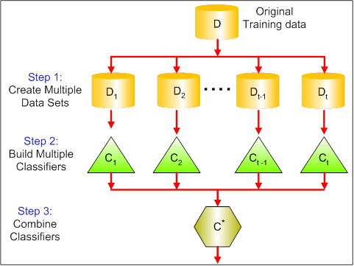
bagging
BAGGING gets its name because it combines Bootstrapping and Aggregation to form one ensemble model
Given a sample of data, multiple bootstrapped subsamples are pulled
Tries to implement similar learners on small sample populations and then takes a mean of all the predictions.
In generalized bagging, you can use different learners on different population.
Helps us to reduce the variance error.

Slide 18
Bagging - key points
Bagging methods come in many flavors but mostly differ from each other by the way they draw random subsets of the training set (samples and features):
When random subsets of the dataset are drawn as random subsets of the samples, then this algorithm is known as Pasting [B1999].
When samples are drawn with replacement, then the method is known as Bagging [B1996].
When random subsets of the dataset are drawn as random subsets of the features, then the method is known as Random Subspaces [H1998].
Finally, when base estimators are built on subsets of both samples and features, then the method is known as Random Patches [LG2012].

Slide 19
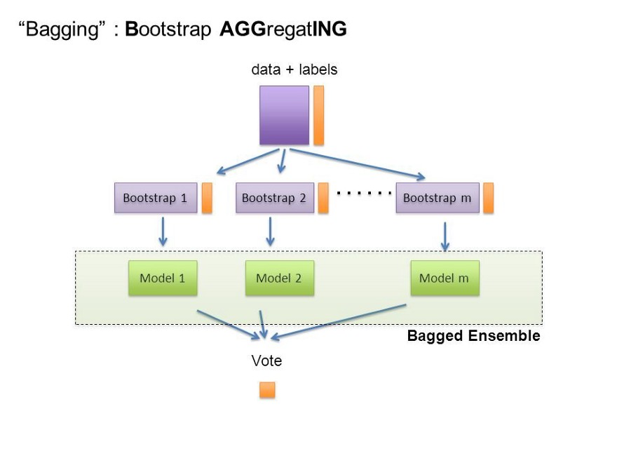
Another view

Slide 20
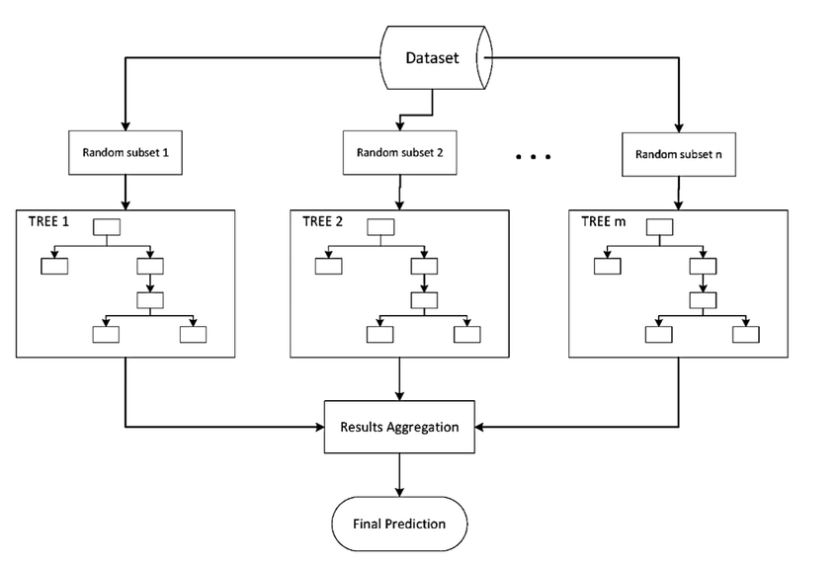
Example – decision tree
Random Forest Models can be thought of as BAGGING

Slide 21
scikit-learn implementation
bagging methods are offered as a unified
BaggingClassifier
BaggingRegressor)
taking as input a user-specified base estimator
Important parameters
max_samples and max_features control the size of the subsets
bootstrap and bootstrap_features control whether samples and features are drawn with or without replacement.
oob_score

Slide 22
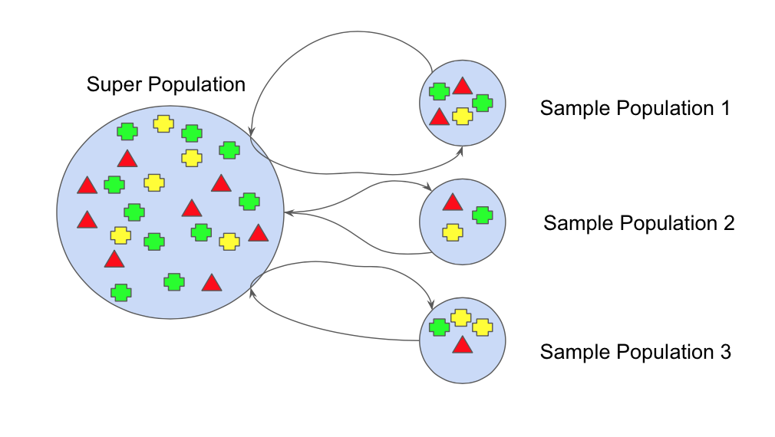
Bootstrapping
the bootstrap method refers to random sampling with replacement.

Slide 23
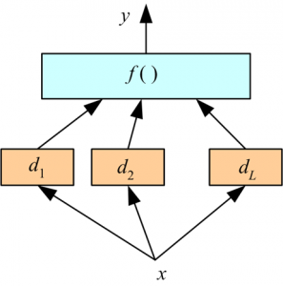
Stacking
combining models.
Here we use a learner to combine output from different learners.
This can lead to decrease in either bias or variance error depending on the combining learner we use.

Slide 24
boosting
Adaboost
Gradient Boosting
Xtreme Gradient Boosting

Slide 25
boosting
Boosting (Freud and Shapire, 1996) - algorithm allowing to fit many weak classifiers to reweighted versions of the training data. Classify final examples by majority voting.
Boosting is an sequential , iterative technique which adjust the weight of an observation based on the last classification.
If an observation was classified incorrectly, it increases the weight of this observation and vice versa.
Boosting in general decreases the bias error and builds strong predictive models.
May sometimes over fit on the training data
Boosting is a method of converting a set of weak learners into strong learners.
Because new predictors are learning from mistakes committed by previous predictors, it takes less time/iterations to reach close to actual predictions.

Slide 26
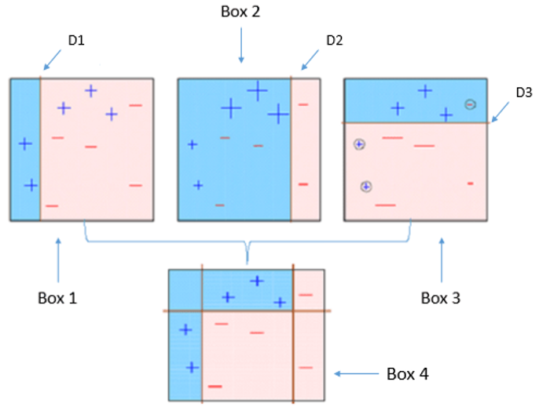
Basic idea
4 classifiers (in 4 boxes) - classify + and – samples
Box 1: The 1st classifier (usually a decision stump) creates a vertical line (split) at D1.
anything to the left of D1 is + and anything to the right of D1 is -
However, this classifier misclassifies three + points.
Box 2: The 2nd classifier gives more weight to the 3 + misclassified points (see the bigger size of +) and creates a vertical line at D2.
anything to the right of D2 is - and left is +.
Still, it makes mistakes by incorrectly classifying 3 - points.
Box 3: the 3rd classifier gives more weight to the 3 - misclassified points and creates a horizontal line at D3.
- Still, this classifier fails to classify the points (in the circles) correctly.
Box 4: This is a weighted combination of the weak classifiers (Box 1, 2 and 3).

Slide 27
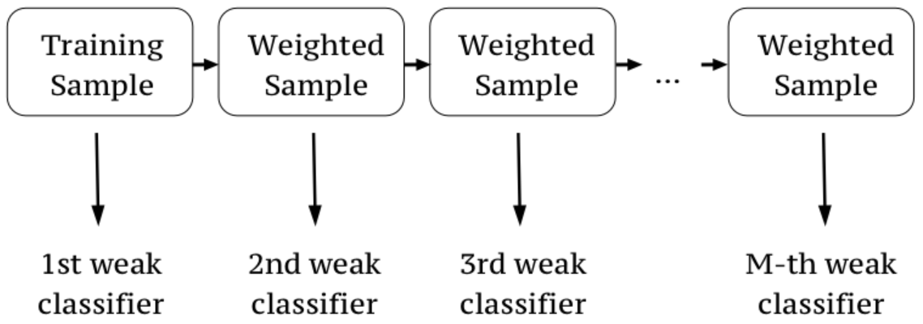
Idea of boosting
All instances in dataset are assigned a score that tells how difficult to classify they are.
Iteratively, the algorithm assign bigger weights to instances that were wrongly classified previously.
In the first iteration all instances weights are equal.
Final Classifier

Slide 28
Base classifiers
Any algorithm can be used as a base for boosting technique,
but trees are more suitable candidates.
Pro's
computational scalability
handling missing values
robust to outliers
does not require feature scaling
can deal with irrelevant inputs
interpretable (if small)
can handle mixed predictors (quantitative and qualitative)
Con's
can't extract linear combination of features
small predictive power (high variance)

Slide 29
Types of boosting algorithms
The different types of boosting algorithms are:
AdaBoost
Gradient Boosting (GBT)
XGBoost (XGB)
These 3 algorithms have gained huge popularity, especially XGBoost, which has been responsible for winning many data science competitions.

Slide 30
How XGBoost helps
Most tree bases algorithms grow deep and create similar trees
sometimes quite bushy.
GBM tries to solve this problem by adding some regularization parameters.
control tree structure (maximum depth, minimum samples per leaf)
control learning rate (shrinkage) - lambda/alpha
reduce variance by introducing randomness (stochastic gradient boosting - using random subsamples of instances and features)
XGBoost improves it further
XGBoost (extreme gradient boosting) is a more regularized version of Gradient Boosted Trees.
Developed by Tianqi Chen in C++ but also enables interfaces for Python, R, Julia.

Slide 31
How XGBoost helps
The main advantages:
good bias-variance (simple-predictive) trade-off "out of the box"
great computation speed
package is evolving

Slide 32
adaboost

Slide 33
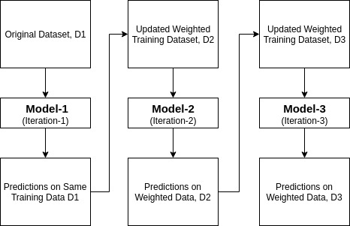
Adaboost - How it works
A single algorithm may classify the objects poorly.
combine multiple classifiers with selection of training set at every iteration and assigning right amount of weight
Each weak classified sample is trained using a random subset of overall training set.
After training a classifier at any level, adaboost assigns weight to each training item.
Misclassified item is assigned higher weight so that it appears in the training subset of next classifier with higher probability.

Slide 34
AdaBoost
AdaBoost is short for Adaptive Boosting
AdaBoost was originally called AdaBoost.M1 by the author
More recently it may be referred to as discrete Ada Boost. Because it is used for classification rather than regression.
formulated by Yoav Freund and Robert Schapire, 1996
AdaBoost works on improving the areas where the base learner fails. Basically, focuses on classification problems and aims to convert a set of weak classifiers into a strong one. .
Generally, AdaBoost is used with short decision trees. (decision stumps)

Slide 35
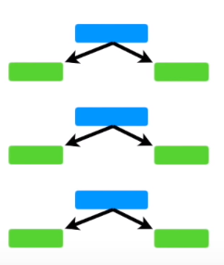
Adaboost vs dt/rf
A tree with just 1 node and 2 leaves is called a decision STUMP
Adaboost is Forest of Stumps
Usually a decision tree uses all the features to calculate the entropy/Gini index – information gain – then it makes the split decision (classification)
But a Stump can only use one feature to make a decision. Hence Stumps are “weak learners”
In a random forest. Each tree’s vote has equal vote in terms of final classification.

Slide 36
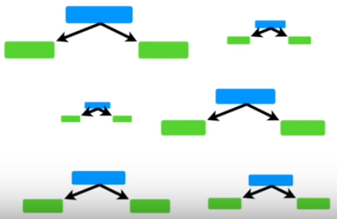
Adaboost vs dt/rf
In contrast, in a forest of stumps made with Adaboost, some stumps get more say in the final classification than others.
The larger stumps get more say in the final classification than the smaller stump
In a random forest, the trees are constructed independent of each other.
In Adaboost forest of stumps, errors in the first stump determine the second stump and so on so forth … (sequential)

Slide 37
Example dataset
Refer to
adaboost-ex1.xlsx

Slide 38

Stump, total error, amount of say
Initial sample weight is = 1/ (total number of samples)
Total Error for a stump = Sum of the weights associated with the incorrectly classified samples.
All the sample weights add up to 1, the Total Error will be
0 for a perfect stump
1 for a messed up stump
We use the Total Error to determine the ‘Amount of Say” a particular stump has in the final classification, as below ….
If the Total Error = 0 or 1 then the formula returns UNDEFINED. Hence a small error term is added

Slide 39
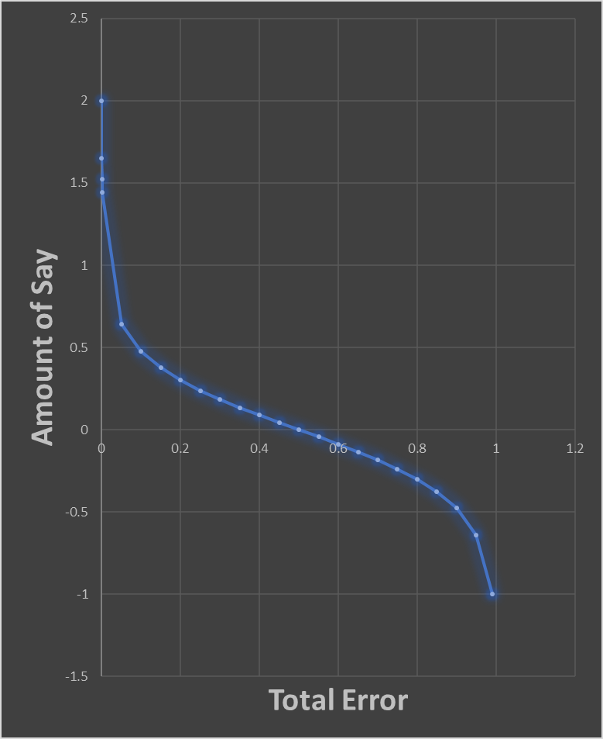
Amount of say of a stump
When a stump does a good job and the Total Error is very small, then the Amount of Say is relatively large positive value.
When a stump is no better at classification than a tossing a coin and the Total Error = 0.5, the Amount of Say = 0
When the stump does a terrible job and the Total Error is close to 1, then the Amount of Say = large negative value
It means if a stump votes for “Heart disease”, the negative ‘Amount of Say” will turn that vote into “Not a heart disease”

Slide 40
Modify the weights
When we created the FIRST stump (patient weight > 176), all of the sample weights were the same (1/8)
But the FIRST stump incorrectly classified a sample
the first decision STUMP "patient weights" misclassified 1 samples. So we will find out a way for the next stump to correctly classify it by increasing it's "Sample Weight" and decreasing all of the other sample weights
Increasing the sample weight :
New sample weight = Sample Weight * e (amount of say of the decision stump)

Slide 41
Modify the weights
the first decision STUMP "patient weights" misclassified 1 sample. So we will find out a way for the next stump to correctly classify it by increasing it's "Sample Weight" and decreasing all of the other sample weights
Increasing the sample weight :
New sample weight = old Sample Weight * e ^{(amount of say)}
Decreasing the sample weight :
New sample weight = Sample Weight * e ^{(-amount of say)}
Maintain the new sample weights

Slide 42
sklearn.ensemble.AdaBoostClassifier
AdaBoost classifier is a meta-estimator that begins by fitting a classifier on the original dataset and then fits additional copies of the classifier on the same dataset but where the weights of incorrectly classified instances are adjusted such that subsequent classifiers focus more on difficult cases.
implements the algorithm known as AdaBoost-SAMME

Slide 43
parameters
class sklearn.ensemble.AdaBoostClassifier(base_estimator=None, n_estimators=50, learning_rate=1.0, algorithm=’SAMME.R’, random_state=None)[source]¶
base_estimator : object, optional (default=None)
The base estimator from which the boosted ensemble is built. If None, then the base estimator is DecisionTreeClassifier(max_depth=1)

Slide 44
parameters
class sklearn.ensemble.AdaBoostClassifier(base_estimator=None, n_estimators=50, learning_rate=1.0, algorithm=’SAMME.R’, random_state=None)[source]¶
n_estimators : integer, optional (default=50)

Slide 45
parameters
class sklearn.ensemble.AdaBoostClassifier(base_estimator=None, n_estimators=50, learning_rate=1.0, algorithm=’SAMME.R’, random_state=None)[source]¶
learning_rate : float, optional (default=1.)
Learning rate shrinks the contribution of each classifier by learning_rate. There is a trade-off between learning_rate and n_estimators.

Slide 46
parameters
class sklearn.ensemble.AdaBoostClassifier(base_estimator=None, n_estimators=50, learning_rate=1.0, algorithm=’SAMME.R’, random_state=None)[source]¶
algorithm : {‘SAMME’, ‘SAMME.R’}, optional (default=’SAMME.R’)
If ‘SAMME.R’ then use the SAMME.R real boosting algorithm.
base_estimator must support calculation of class probabilities.
If ‘SAMME’ then use the SAMME discrete boosting algorithm. The SAMME.R algorithm typically converges faster than SAMME, achieving a lower test error with fewer boosting iterations.

Slide 47
attributes
estimators_ : list of classifiers, The collection of fitted sub-estimators.
classes_ : array of shape = [n_classes] - The classes labels.
n_classes_ : int - The number of classes.
estimator_weights_ : array of floats - Weights for each estimator in the boosted ensemble.
estimator_errors_ : array of floats - Classification error for each estimator in the boosted ensemble.
feature_importances_ : array of shape = [n_features] - Return the feature importances (the higher, the more important the feature).

Slide 48
Gradient boosting

Slide 49
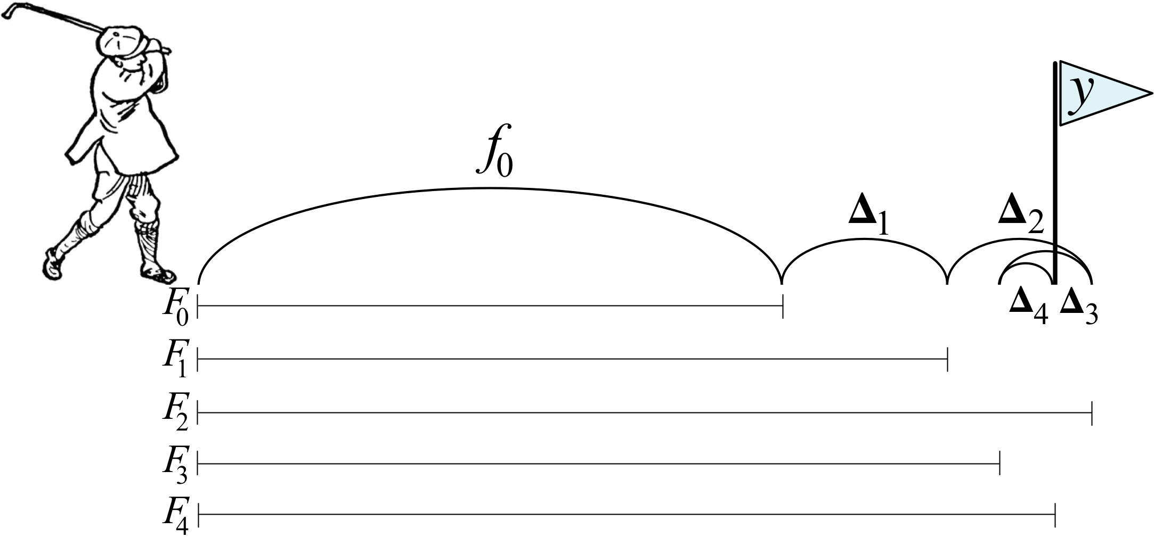
Gradient Boosting algorithm
Gradient boosting machines (GBMs) are currently very popular
Gradient boosting is a machine learning technique for regression and classification problems, which produces a prediction model in the form of an ensemble of weak prediction models, typically decision trees. (Wikipedia definition)

Slide 50

GB and Adaboost
Gradient boost is very similar to Adaboost
Height (m) | Favorite Color | Gender | Weight (Kg)
1.6 | Blue | M | 78
1.5 | Green | F | 69
1.65 | Red | F | 67
Adaboost starts by building a very short tree called STUMP
Adaboost builds the next STUMP based on the errors that previous stump made … Here the new stump did a poor job compensating for the previous stump’s errors and size reflects the amount of say
Adaboost builds another stump based on the errors … and this stump did better than the previous one. So it is larger
… more and more stump until it has made the number of stumps you asked for or it has a perfect fit

Slide 51

GB – contrast with Adaboost
In contrast, the Gradient boost …creates a leaf
Height (m) | Favorite Color | Gender | Weight (Kg)
1.6 | Blue | M | 78
1.5 | Green | F | 69
1.65 | Red | F | 70
71.2
The leaf represents an initial guess for the weights of all the samples
In case of regression, the first guess is the average value
Then GB builds a tree.
Like Adaboost, this tree is based on errors made by the previous tree.
But unlike Adaboost, this tree is larger than a stump.
But GB still restricts the size of tree to 4 leaves. Practical projects often set this number {8, 32}
Also like Adaboost, GB scales the trees. However the GB scales all the trees by same amount
… and GB continues to build trees in this fashion until it has the number of trees you asked for or additional trees fail to improve the fit

Slide 52
Gradient boost - configuration
Average weight
Height (m) | Favorite Color | Gender | Weight (Kg)
1.6 | Blue | M | 88
1.5 | Green | F | 76
1.65 | Red | F | 56
 |  |  | 73
 |  |  | 77
 |  |  | 57
The first things we do is calculate the average weight of all the people. This is the first attempt at predicting everyone’s weight
If we stop here, we can say everyone weighs 73.35kg
71.2
… the next thing is build a tree based on the errors from the first tree
Errors = (actual wt – pred wt)

Slide 53
Gradient boost - configuration
Height (m) | Favorite Color | Gender | Weight (Kg) | Residual
1.6 | Blue | M | 88 | 16.8
1.6 | Green | F | 76 | 4.8
1.5 | Blue | F | 56 | -15.2
1.8 | Red | M | 73 | 1.8
1.5 | Green | M | 77 | 5.8
1.4 | Blue | F | 57 | -14.2
 |  |  |  | -5.35
… Now we will build a Tree using
Height
Favorite color
Gender
To predict the residuals –
** strange **
Average weight
71.2

Slide 54
Gradient boost - configuration
Height (m) | Favorite Color | Gender | Weight (Kg) | Residual
1.6 | Blue | M | 88 | 16.8
1.6 | Green | F | 76 | 4.8
1.5 | Blue | F | 56 | -15.2
1.8 | Red | M | 73 | 1.8
1.5 | Green | M | 77 | 5.8
1.4 | Blue | F | 57 | -14.2
 |  |  |  | -5.35
Gender=F
Height<1.6
Color Not Blue
-14.2, -15.2
4.8
1.8, 5.8
16.8
averaging
averaging
(-14.2 – 15.2)/2 = -14.7
3.8
Average weight
71.2
Number of leaves = 4
Since we are restricting the number of leaves, the leaves are less than the number of residuals.
As a results, multiple residuals end up in the same leaf. Average them.

Slide 55
Gradient boost - configuration
Average weight
71.2
Gender=F
GB takes the initial weight for one sample
Adds (learning rate X residual of the sample
Learning rate is a value between 0, 1. we will set the learning rate = 0.1
Now the predicted weight = 71.2 * (0.1 * 16.8) = 72.9
The prediction is a little bit better than the original leaf which predicted all samples would weigh 71.2
In other words, scaling the tree by the learning rate results in a small step in the right direction
Height<1.6
Color Not Blue
-14.2, -15.2
4.8
1.8, 5.8
16.8
averaging
averaging
(-14.2 – 15.2)/2 = -14.7
3.8
According to Jerome Friedman who invented “Gradient Boost”, empirical evidence shows taking lots of small steps in the right direction results in better ‘predictions’ with a new testing dataset … LOWER VARIANCE

Slide 56
Gradient boost - configuration
Height (m) | Favorite Color | Gender | Weight (Kg) | Original Residual | new pred | New residual
1.6 | Blue | M | 88 | 16.8 | 72.88 | 15.12
1.6 | Green | F | 76 | 4.8 | 71.68 | 4.32
1.5 | Blue | F | 56 | -15.2 | 69.68 | -13.68
1.8 | Red | M | 73 | 1.8 | 71.38 | 1.62
1.5 | Green | M | 77 | 5.8 | 71.78 | 5.22
1.4 | Blue | F | 57 | -14.2 | 69.78 | -12.78
The new Residuals are all smaller than before, so we have taken a small step in the right direction
Average weight
71.2

Slide 57
Gradient boost - configuration
Tree - 1
Tree - 2
Initial leaf
Gender=F
Gender=F
71.2
Height<1.6
Color Not Blue
Height<1.6
Color Not Blue
-14.2, -15.2
4.8
1.8, 5.8
16.8
-13,68, -12.78
4.32
1.62, 5.22
15.12
averaging
averaging
averaging
averaging
-14.7
3.8
-13.23
3.42
Combine the new tree with the previous tree and the initial leaf.
We scale all of the trees by the same learning rate which we set to 0.1
Add all pieces together
71.2 + 0.1 * 16.8 + 0.1 * 15.12 = 74.4

Slide 58
Gradient boost - configuration
Combine Tree-1 and Tree-2
Height (m) | Favorite Color | Gender | Weight (Kg) | Tree -1 (Prediction) | Original residual | new pred | New residual | new pred | New residual
1.6 | Blue | M | 88 | 71.2 | 16.8 | 72.85 | 15.15 | 74.36 | 13.64
1.6 | Green | F | 76 | 71.2 | 4.8 | 71.68 | 4.32 | 72.08 | 3.92
1.5 | Blue | F | 56 | 71.2 | -15.2 | 69.68 | -13.68 | 68.28 | -12.28
1.8 | Red | M | 73 | 71.2 | 1.8 | 71.38 | 1.62 | 71.51 | 1.49
1.5 | Green | M | 77 | 71.2 | 5.8 | 71.78 | 5.22 | 72.27 | 4.73
1.4 | Blue | F | 57 | 71.2 | -14.2 | 69.78 | -12.78 | 68.47 | -11.47
 |  | Initial weight | 71.2
The new Residuals are all smaller than before, so we have taken a small step in the right direction

Slide 59
Gradient boost - configuration
Initial leaf
Tree - 1
Tree - 2
Tree - 3
71.2
Gender=F
Gender=F
Gender=F
Height<1.6
Color Not Blue
Height<1.6
Color Not Blue
Height<1.6
Color Not Blue
-14.2, -15.2
4.8
1.8, 5.8
16.8
-13,68, -12.78
4.32
1.62, 5.22
15.12
-12.28, -11.47
3.92
1.49, 4.73
13.64
averaging
averaging
averaging
averaging
averaging
averaging
-14.7
3.8
-13.23
3.42
-13.23
3.42
Combine the new tree with the previous 2 trees and the initial leaf.
We scale all of the trees by the same learning rate which we set to 0.1
Add all pieces together
71.2 + 0.1 * 16.8 + 0.1 * 15.12 + 0.1 * 13.64 = ?? (check if this is closer to the fit)
We keep making trees until we reach the maximum specified or adding additional trees does not significantly reduce the size of the residuals

Slide 60
So how do we predict
New samples for test
Start with initial leaf = 71.2
+ tree 1 residual * learning rate
+ tree 2 residual * learning rate
+ tree 3 residual * learning rate … …

Slide 61
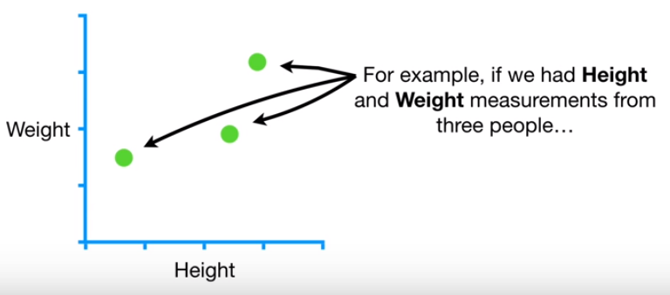
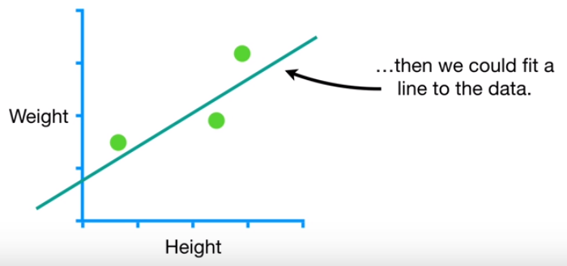
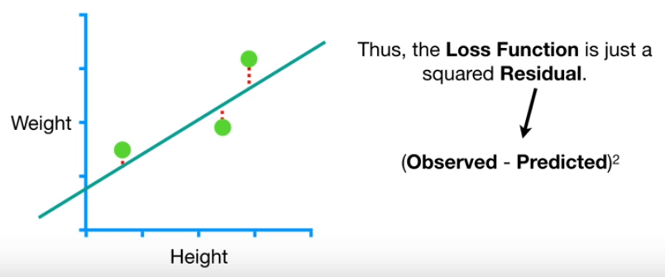
Maths of gradient boosting
Height | Favorite Color | Gender | Weight
1.6 | Blue | Male | 88
1.6 | Green | Female | 76
1.5 | Blue | Female | 56
X₁
X₂
X₃
y₃
Loss function = ½ * (actual – pred)²

Slide 62
Maths of gradient boosting
STEP 1:
[−(88−pred)]+[−(76−pred)]+[−(56−pred)]=0
pred + pred + pred = 88 + 76 + 56
pred = 73.3
that means that the initial predicted value, F0(x)F0(x) is just a leaf = 73.3. this leaf predicts all samples would weigh 73.3kg

Slide 63
Maths of gradient boosting
STEP 2:
(A) Calculate residual for each sample
Initial leaf : 73.3kg
(B) Build regression tree to predict the residuals instead of weights
Height | Favorite Color | Gender | Weight | Residual r_{i,1}
1.6 | Blue | Male | 88 | r_{1,1} = 88-73.3 = 14.7
1.6 | Green | Female | 76 | r_{2,1} = 76-73.3 = 2.7
1.5 | Blue | Female | 56 | r_{3,1} = 56-73.3 = -17.3
Height < 1.55
-17.3
14.7, 2.7

Slide 64
Gradient boosting - classification
Gradient boosting has a lot in common with Logistic Regression
Likes popcorn | Age | Favorite Color | Likes to Gym
Y | 12 | Blue | Y
Y | 87 | Green | Y
N | 44 | Blue | N
Y | 19 | Red | N
N | 32 | Green | Y
N | 14 | Blue | Y

Slide 65
configuration
Average weight
Age | Fav_color | Likes_popcorn | Likes_gym
12 | Blue | Y | Y
87 | Green | Y | Y
44 | Blue | N | N
19 | Red | Y | N
32 | Green | N | Y
14 | Blue | N | Y
The first things we do is calculate the initial Prediction of all the people. This is the first attempt at predicting everyone’s liking for gym
This is sort of log(odds) as we saw in Logistic Regression, equivalent of average.
71.2
… the next thing is build a tree based on the errors from the first tree
Errors = (actual wt – pred wt)

Slide 66
summary
When we use GB for regression,
We start with a leaf that is average value of the variable we want to predict
Add a tree based on the residuals (= actual – predicted)
Scale the tree’s contribution with a learning rate
Then we add another tree based on the new residuals
And we keep adding trees till the error is zero OR max tree setting has maxed out

Slide 67
sklearn.ensemble.GradientBoostingClassifier
class sklearn.ensemble.GradientBoostingClassifier(loss=’deviance’, learning_rate=0.1, n_estimators=100, subsample=1.0, criterion=’friedman_mse’, min_samples_split=2, min_samples_leaf=1, min_weight_fraction_leaf=0.0, max_depth=3, min_impurity_decrease=0.0, min_impurity_split=None, init=None, random_state=None, max_features=None, verbose=0, max_leaf_nodes=None, warm_start=False, presort=’auto’, validation_fraction=0.1, n_iter_no_change=None, tol=0.0001)[source]

Slide 68
xgboost
XGBoost stands for eXtreme Gradient Boosting. Also known as ‘regularized boosting‘ technique.
XGBoost is an variant of gradient boosted decision trees designed for speed and performance.
An open source tool (computation in C++, R/Python interface provided)
3 main forms of gradient boosting are supported:
Gradient Boosting algorithm also called gradient boosting machine including the learning rate.
Stochastic Gradient Boosting with sub-sampling at the row, column and column per split levels.
Regularized Gradient Boosting with both L1 and L2 regularization.
default base learners of XGBoost: tree ensembles
Trees are grown one after another ,and attempts to reduce the misclassification rate are made in subsequent iterations.

Slide 69
XGB – salient features
Features
Regularization | Supports in built regularization (unlike GBM models)
Parallel Processing | On a single machine, can be run on a cluster
Handling Missing Values | has an in-built routine to handle missing values. XGBoost tries different things as it encounters a missing value on each node and learns which path to take for missing values in future.
Tree Pruning | splits up to the max_depth
Built-in Cross-Validation
Continue on Existing Model | User can start training an XGBoost model from its last iteration of previous run. This can be of significant advantage in certain specific applications.

Slide 70
XGBoost Parameters
General Parameters | Booster Parameters | Learning Task Parameters
booster [default=gbtree] - type of model to run at each iteration. gbtree: tree-based models gblinear: linear models | eta [default=0.3] learning rate Typical final values : 0.01-0.2 | objective [default=reg:linear] defines the loss function to be minimized binary:logistic multi:softmax
silent [default=0]: | min_child_weight [default=1] Used to control over-fitting. Too high values can lead to under-fitting tuned using CV. | eval_metric rmse, mae – auc Logloss, mlogloss Error, merror mlogloss – Multiclass logloss
nthread (default is max number of threads if not set) | max_depth [default=6] Used to control over-fitting Too high values can lead to over-fitting tuned using CV Typical values 3 -10 | seed [default=0] The random number seed. Can be used for generating reproducible results and also for parameter tuning.
 | max_leaf_nodes
 | gamma [default=0] minimum loss reduction required for a split Depends on the loss function Tuning needed

Slide 71
XGBoost Parameters
General Parameters | Booster Parameters | Learning Task Parameters
 | max_leaf_nodes
 | gamma [default=0] minimum loss reduction required for a split Depends on the loss function Tuning needed
 | subsample [default=1] % of observations to be randomly sampled for each tree. Typical values : 0.5 to 1
 | lambda [default=1] L2 regularization term (RIDGE)
 | alpha [default=0] L1 regularization term (LASSO)

Slide 72
Important
Choosing the right ensembles is more of an art than straight forward science.
Which ensemble learner to use in different kinds of scenario and base learners, comes with experience and domain knowledge

Slide 73
Important
No single algorithm performs best or worst.
This is wisdom known to machine learning practitioners, but difficult to grasp for beginners in the field.
There is no silver bullet and you must test a suite of algorithms on a given dataset to see what works best.
“… it is worth noting that no one ML algorithm performs best across all 165 datasets. For example, there are 9 datasets for which Multinomial NB performs as well as or better than Gradient Tree Boosting, despite being the overall worst- and best-ranked algorithms, respectively. Therefore, it is still important to consider different ML algorithms when applying ML to new datasets.”

Slide 74
Adaboost vs gradient boosting
Adaboost | Gradient Boosting
‘shortcomings’ are identified by high-weight data points. ‘Amount of say’ etc | ‘shortcomings’ (of existing weak learners) are identified by gradients.

Slide 75
end

Slide 76
Voting and Averaging Based Ensemble Methods
Voting and averaging are two of the easiest ensemble methods.
Voting is used for classification
averaging is used for regression.
In both methods, the first step is to create multiple classification/regression models using some training dataset.
Each base model can be created using different splits of the same training dataset and same algorithm, or using the same dataset with different algorithms, or any other method.

Slide 77
pseudocode
train = load_csv("train.csv")
target = train["target"]
train = train.drop("target")
test = load_csv("test.csv")
algorithms = [logistic_regression, decision_tree_classification, ...] # for classification
algorithms = [linear_regression, decision_tree_regressor, ...] # for regression
predictions = matrix(row_length=len(target), column_length=len(algorithms))
for i, algorithm in enumerate(algorithms):
model = algorithm.fit(train, target)
predictions[,i] = model.predict(test)
predictions for each model saved in a matrix, where each column contains predictions from one model.

Slide 78
Majority Voting
Every model makes a prediction (votes) for each test instance
Final output prediction is the one that receives more than half of the votes. (majority)
If none of the predictions get more than half of the votes, we may say that the ensemble method could not make a stable prediction for this instance.
Most voted prediction (even if that is less than half of the votes) as the final prediction.
Also called “plurality voting”

Slide 79
Weighted Voting
importance of one or more models.
In weighted voting count the prediction of the better models multiple times.
Finding a reasonable set of weights is up to the analyst.

Slide 80
Simple Averaging
In simple averaging method, for every instance of test dataset, the average predictions are calculated.
The following pseudocode code shows this simple averaging method:
final_predictions = []
for row_number in len(predictions):
final_predictions.append(
mean(prediction[row_number, ])
)

Slide 81
Weighted Averaging
Modified version of simple averaging, where the prediction of each model is multiplied by the weight and then their average is calculated.
The following pseudocode code shows the weighted averaging:
weights = [..., ..., ...] # length is equal to len(algorithms)
final_predictions = []
for row_number in len(predictions):
final_predictions.append(
mean(prediction[row_number, ]*weights)
)

